Slide 1
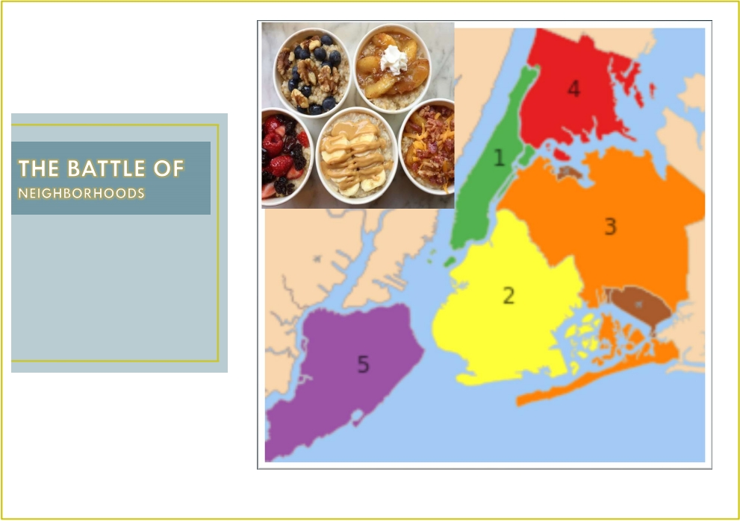
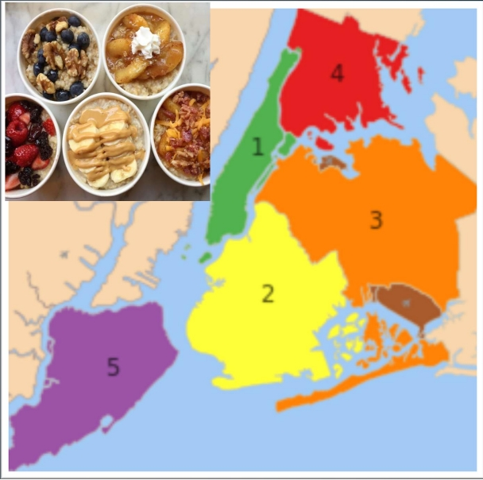

ABC Company Ltd.,
1. Manhattan , 2.Brooklyn , 3. Queens ,
4.The Bronx 5. Staten Island

Slide 2
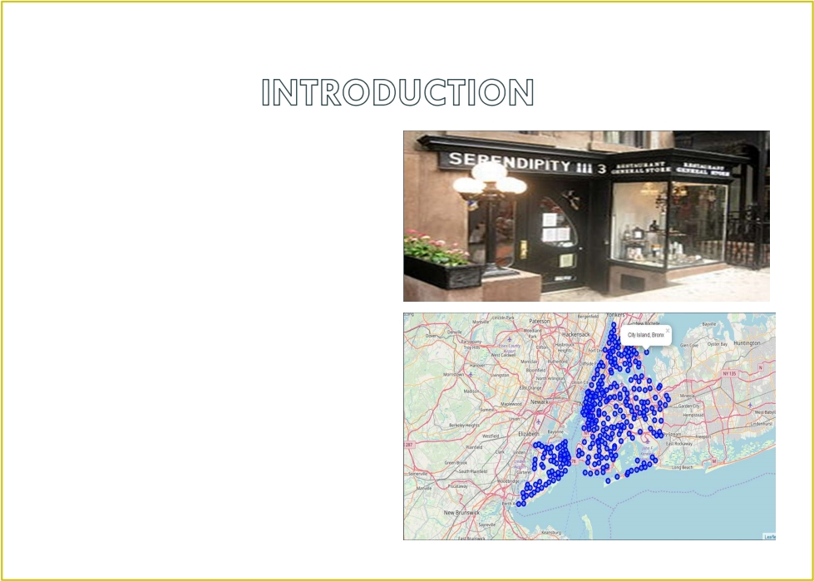

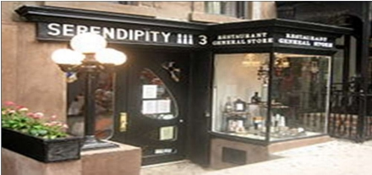
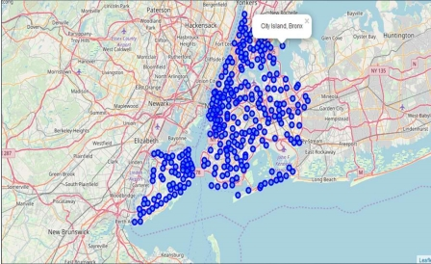
• New York city review for
ABC Company .
• Optimum location for new
Restaurant business
• Business Problem :
- Choice of first neighborhood to
start restaurant business .
- Easy to replicate .
- Low competition
- High demand
- Choice of Menu
• Success Criteria :
- Best neighborhood which meets
above criteria .

Slide 3
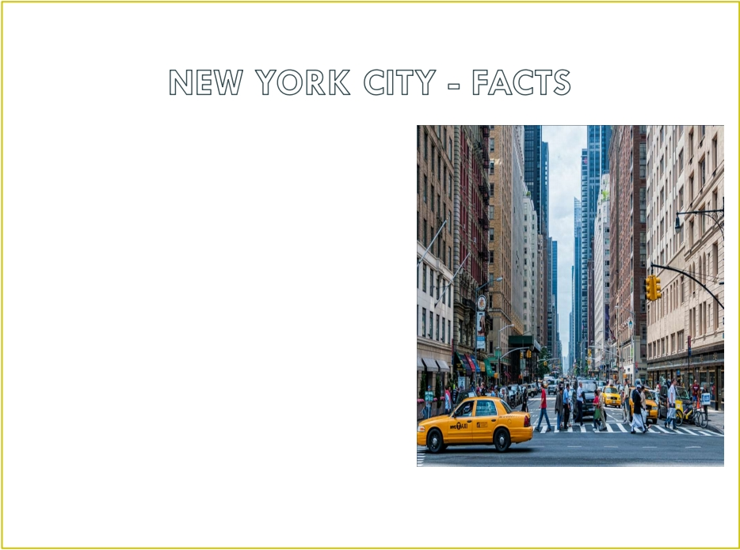


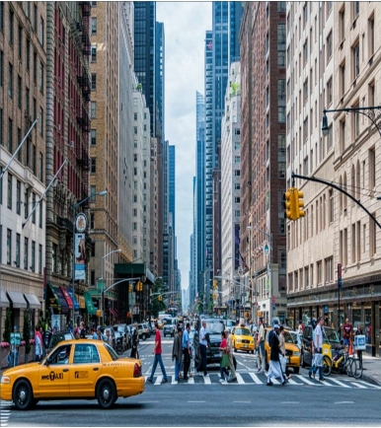
• Most populous city in the United States
• It is diverse and is the financial capital of
USA
• It is multicultural
• Provides lot of business opportunities
• Business friendly environment
• Attracted many different players into the
market
• Global hub of business and commerce .
• The city is a major centre for banking and
finance , retailing , world trade , transportation ,
tourism , real estate , new media , traditional
media , advertising , legal services ,
accountancy , insurance , theatre , fashion , and
the arts in the United States .

Slide 4

• Market is highly competitive
• Highly developed city so cost of doing business is also one of the highest
• New business venture or expansion needs to be analysed carefully
• One should strategically targeting the market inorder to - This will help in
reduction of risk .
- The Return on Investment will be reasonable .

Slide 5



The City of New York is famous for its excellent cuisine . It ' s food culture includes an
array of international cuisines influenced by the city ' s immigrant history .
• Central and Eastern European immigrants , especially Jewish immigrants - bagels ,
cheesecake , hot dogs , knishes , and delicatessens
• Italian immigrants - New York - style pizza and Italian cuisine
• Jewish immigrants and Irish immigrants - pastrami and corned beef
• Chinese and other Asian restaurants , sandwich joints , trattorias , diners , and
coffeehouses are ubiquitous throughout the city
• Mobile food vendors - Some 4,000 licensed by the city
• Middle Eastern foods such as falafel and kebabs examples of modern New York
street food
• Famous for fine dining Michelin starred restaurants . The city is home to
" nearly one thousand of the finest and most diverse haute cuisine restaurants in the
world ", according to Michelin .
• So it is evident that to survive in such competitive market it is very important to
strategically plan .

Slide 6
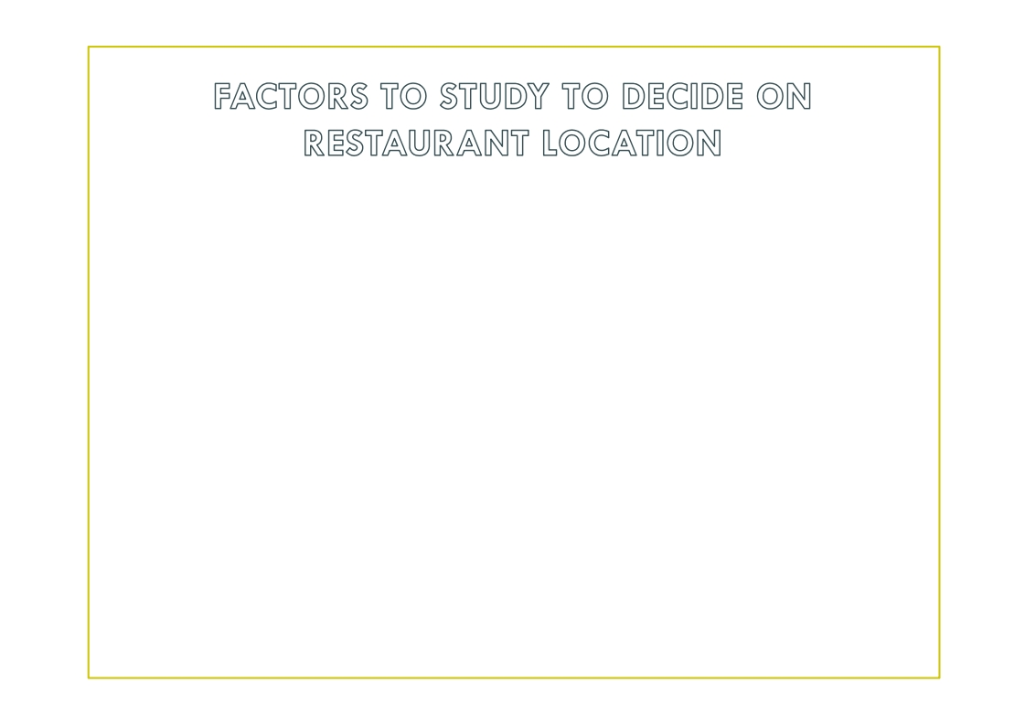
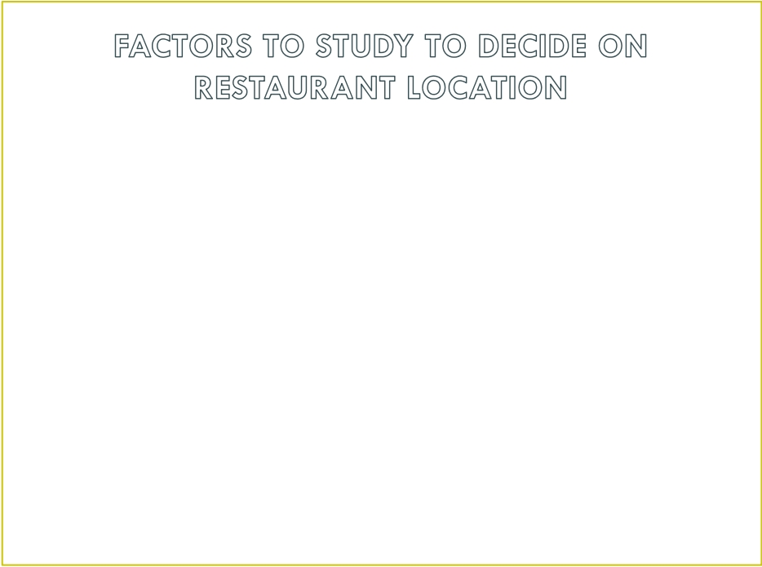
• New York Population
• New York City Demographics
• Are there any Farmers Markets , Wholesale markets etc nearby so that the
ingredients can be purchased fresh to maintain quality and cost ?
• Are there any venues like Gyms , Entertainmnet zones , Parks etc nearby
where floating population is high etc
• Who are the competitors in that location ?
• Cuisine served / Menu of the competitors
• Segmentation of the Borough
• Untapped markets
• Saturated markets etc
The list can go on ...

Slide 7
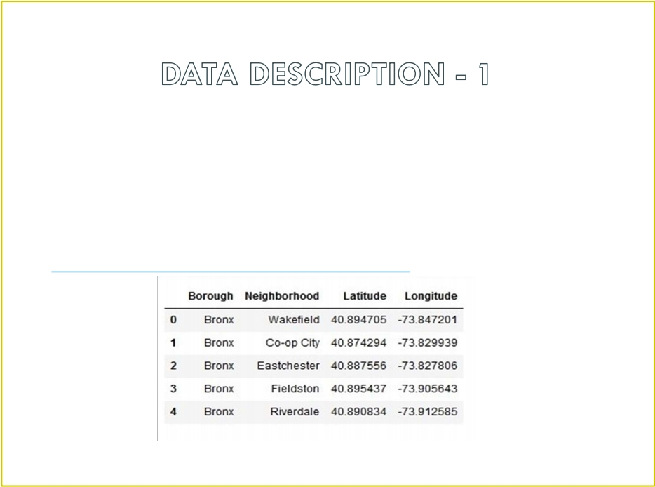
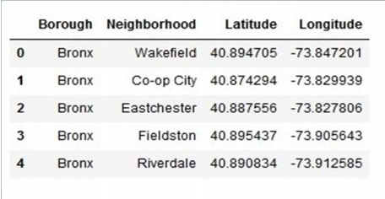
• Data 1 : Neighborhood has a total of 5 boroughs and 306 neighborhoods . In order
to segment the neighborhoods and explore them , we will essentially need a dataset
that contains the 5 boroughs and the neighborhoods that exist in each borough as
well as the latitude and longitude coordinates of each neighborhood .
• This dataset exists for free on the web . Link to the dataset is :
https://geo.nyu.edu/catalog/nyu_2451_34572

Slide 8
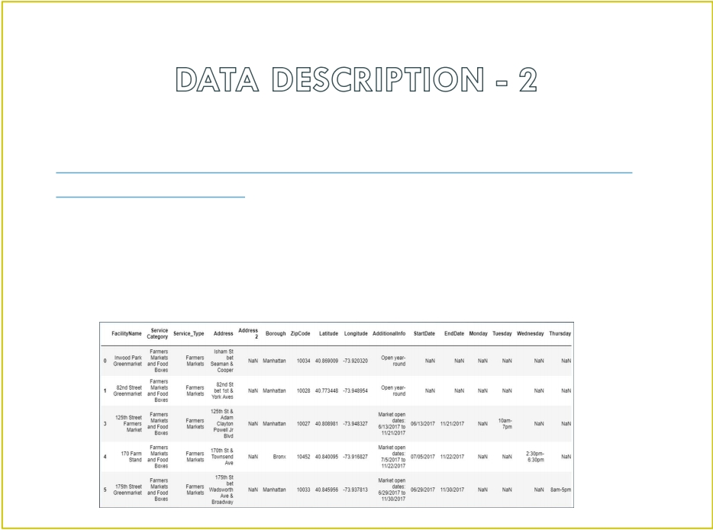


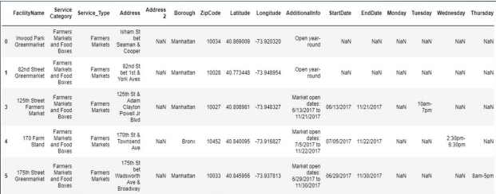
• Data 2 : Farmers Markets data -
• https://data.cityofnewyork.us/dataset/DOHMH-Farmers-Markets-and-
Food-Boxes/8vwk-6iz2
• A farmers ' market is often defined as a public site used by two or more local or
regional producers for the direct sale of farm products to consumers . In addition to
fresh fruits and vegetables , markets may sell dairy products , fish , meat , baked
goods , and other minimally processed foods .

Slide 9
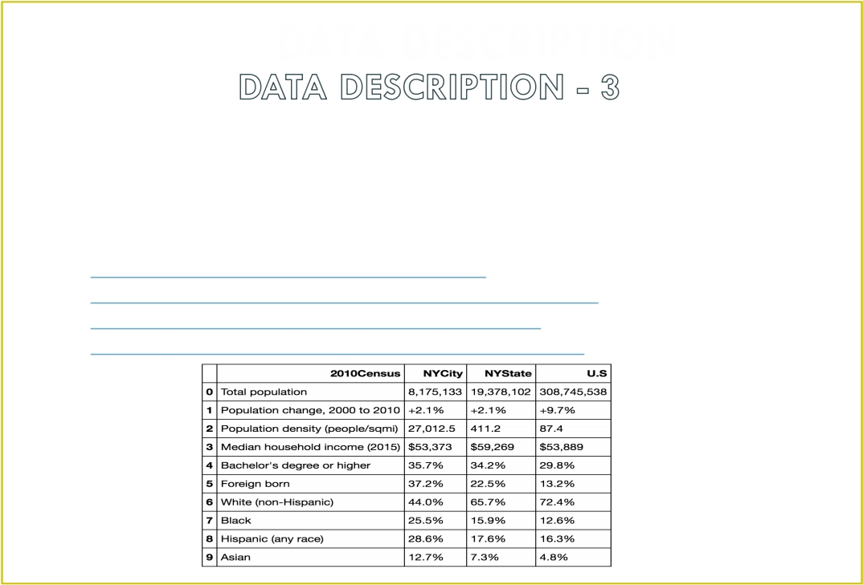
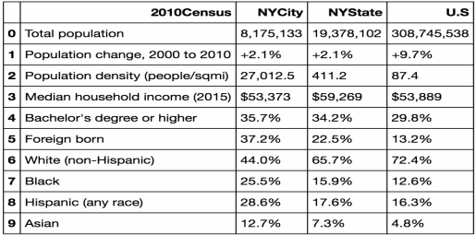
Data 3 : Data from Wikipedia pages as given below :
• New York Population
• New York City Demographics
• Cuisine of New York city
https://en.wikipedia.org/wiki/New_York_City
https://en.wikipedia.org/wiki/Economy_of_New_York_City
https://en.wikipedia.org/wiki/Portal:New_York_City
https://en.wikipedia.org/wiki/Cuisine_of_New_York_City

Slide 10
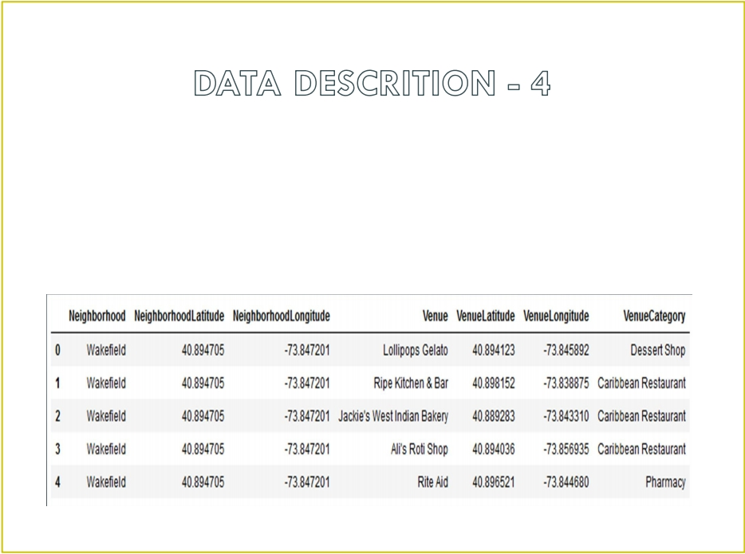
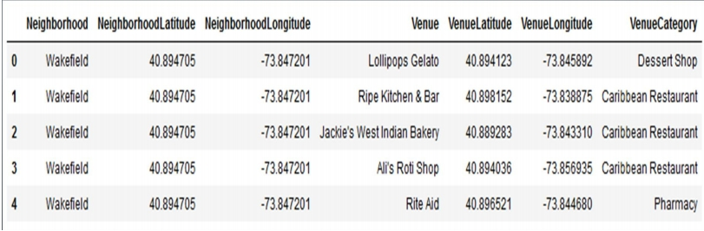
• Data from foursquare . com
Newyork city geographical coordinates data will be utilized as input for the Foursquare
API , that will be leveraged to provision venues information for each neighborhood . We
will use the Foursquare API to explore neighborhoods in New York City . The below is
image of the Foursquare API data .

Slide 11

• New York city neighbourhood has a total of 5 boroughs and 306 neighborhoods
• PART 1 - Clustering of Manhattan and Brooklyn
• PART 2 - Clustering of Bronx , Queens and Staten Island .
• Only restaurant data is filtered from foursquare . com venues data and utilized
for this project .
• This is done because of the following Exploratory data analysis .

Slide 12
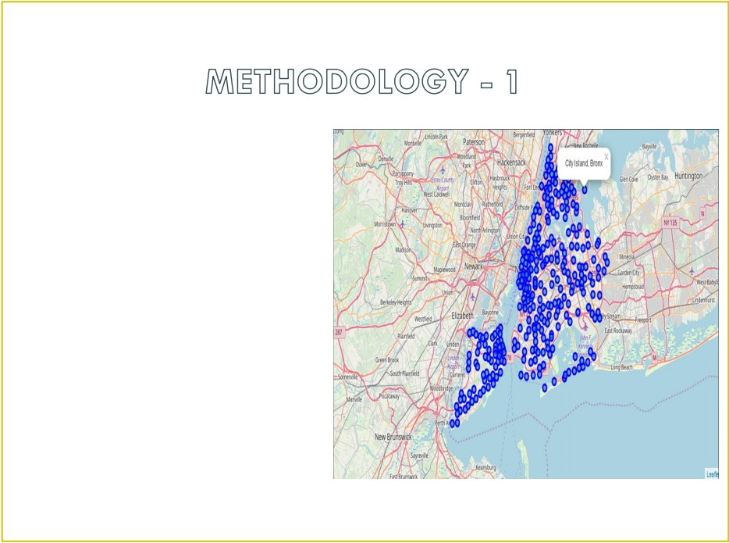


Data 1- New york city
Geographical Coordinates Data . •
Load the data and explore
data - newyork_data . json
• Transform the data of nested
python dictionaries into a
pandas dataframe .
• Dataframe contains the
geographical coordinates of
New York city neighborhoods .
• Data will used to get Venues
data from Foursquare .
• Geopy and folium libraries used to
create a map of New York city with
neighborhoods superimposed on
top .

Slide 13
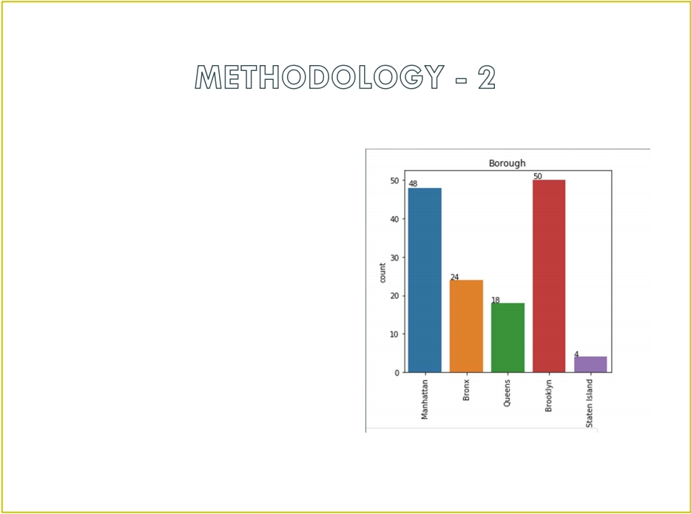
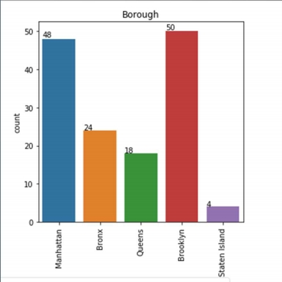
• Data 2- DOHMH Farmers Markets
and Food Boxes dataset .
• In this we will be using the data of
Farmers Markets
• There are totally 144 Farmers Markets
in New York city .
• Highest number are in Manhattan and
Brooklyn . And lowest in Queens , Bronx
and Staten Island .

Slide 14
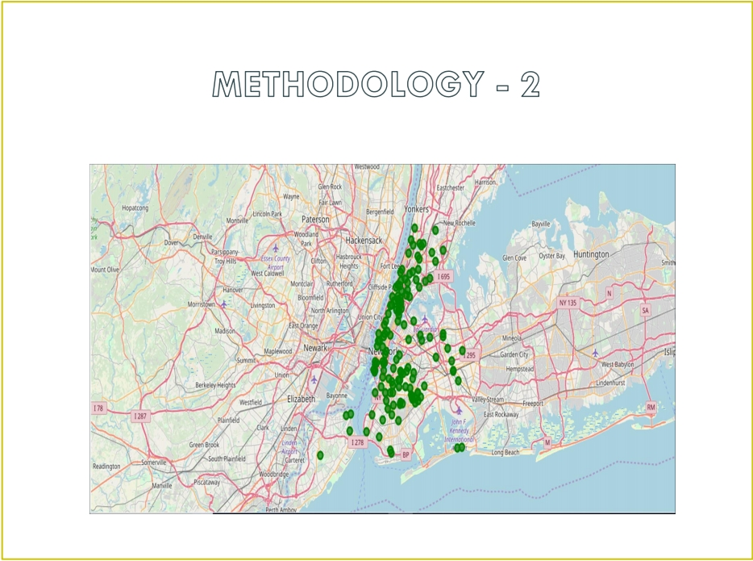
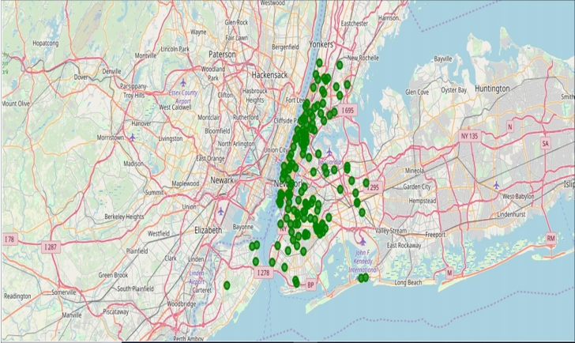
• Farmers Market visualisation - New York City

Slide 15

• Data 3 : To analyize New York city Population , Demographics and Cuisine ,
scrapped the data from Wikipedia pages given above in the data section .
• We used BeautifulSoup python library .
• Beautiful Soup is a Python package for parsing HTML and XML documents ( including
having malformed markup , i . e . non - closed tags , so named after tag soup ).
• It creates a parse tree for parsed pages that can be used to extract data from
HTML , which is useful for web scraping

Slide 16
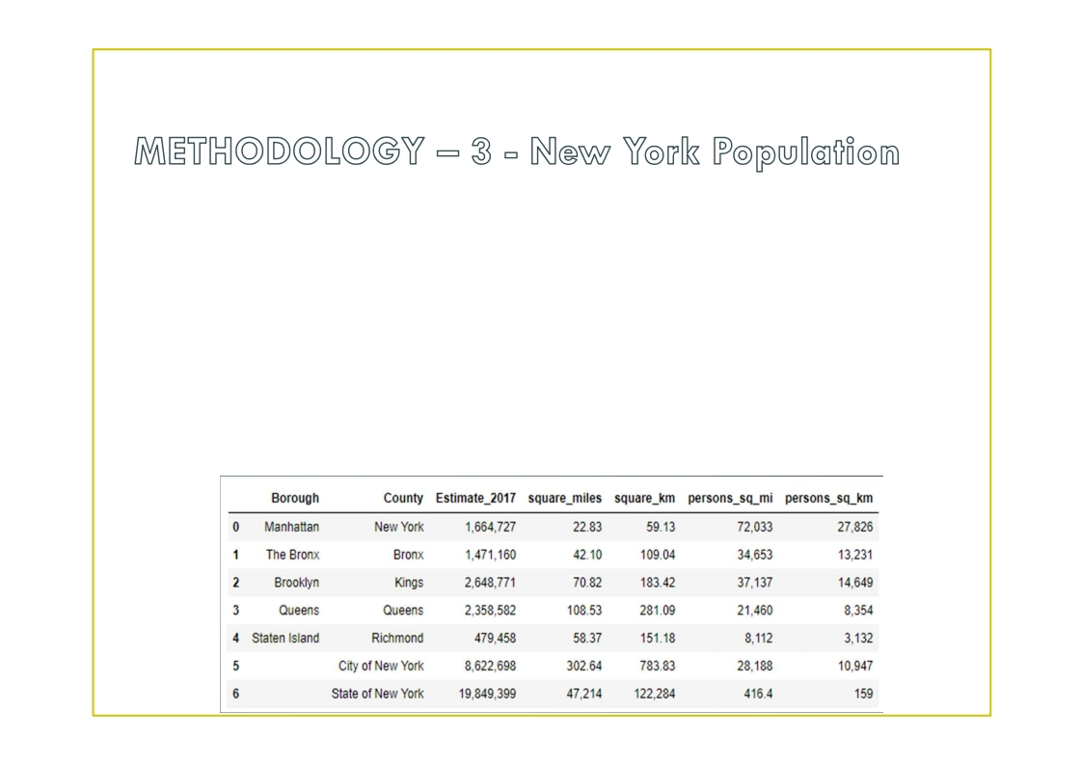
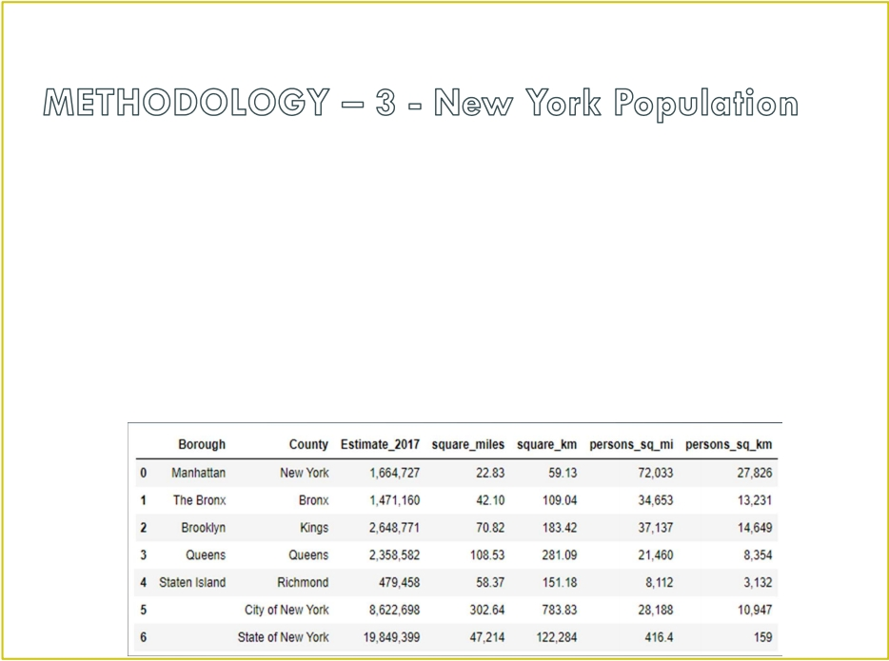
• Manhattan ( New York County ) is the geographically smallest and most
densely populated borough .
• Manhattan ' s ( New York County ' s ) population density of 72,033 people per
square mile (27,812/ km² ) in 2015 makes it the highest of any county in the United
States and higher than the density of any individual American city .
• Brooklyn ( Kings County ), on the western tip of Long Island , is the city ' s most
populous borough .
• Queens ( Queens County ), on Long Island north and east of Brooklyn , is
geographically the largest borough .

Slide 17
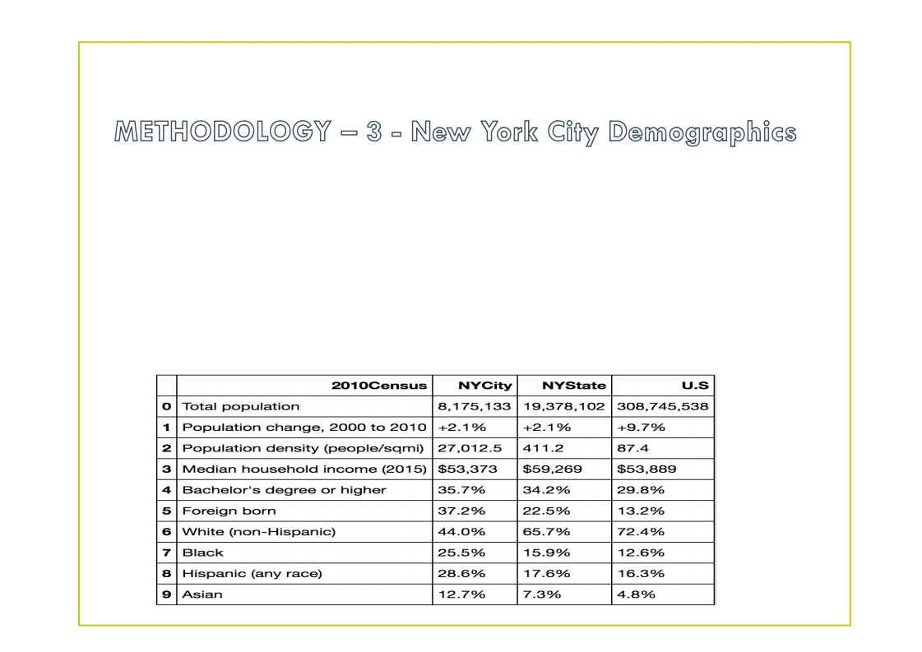
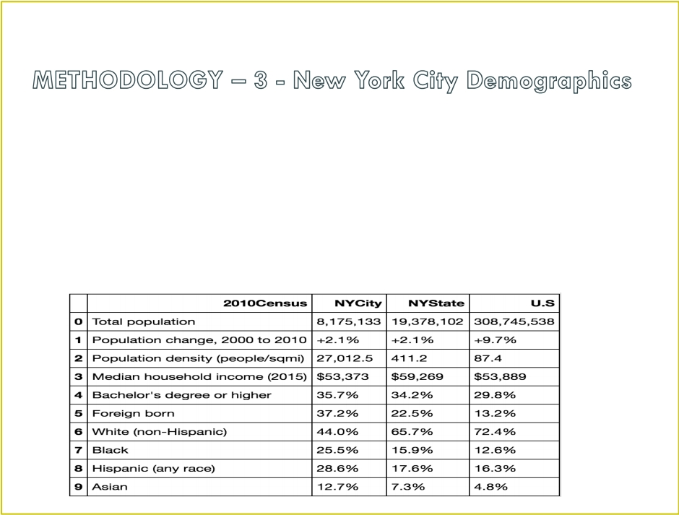
• New York City is the most populous city in the United States , with an estimated
record high of 18,804,000 residents as of 20 20 , incorporating more immigration into
the city than outmigration since the 2010 United States Census .
• The racial composition is as given below . This is the reason New York city has
restaurants serving cuisine from many countries such as India , Africa , Japan etc . This
also increases the scope for restaurants business in New York City .

Slide 18
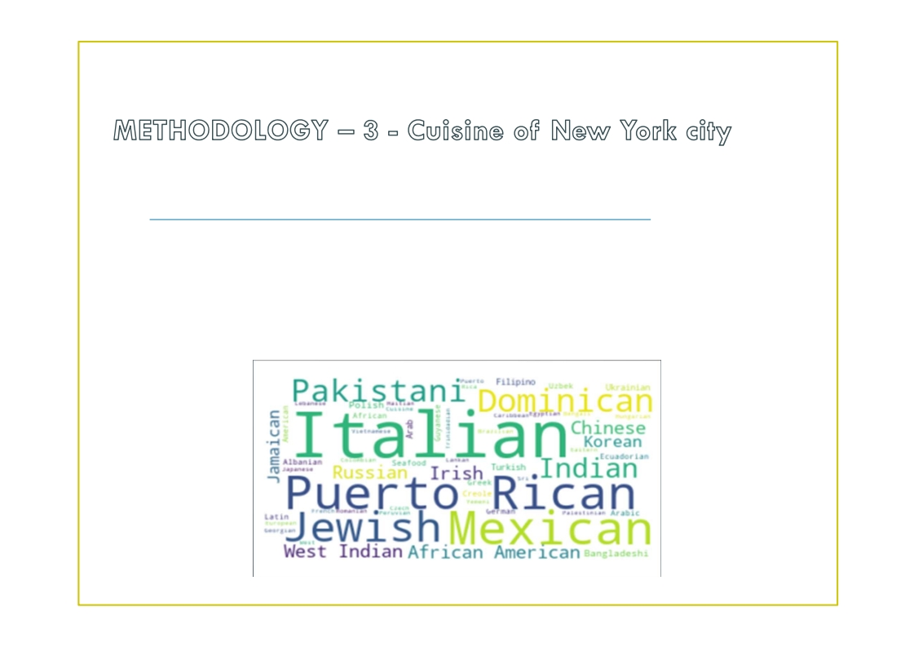
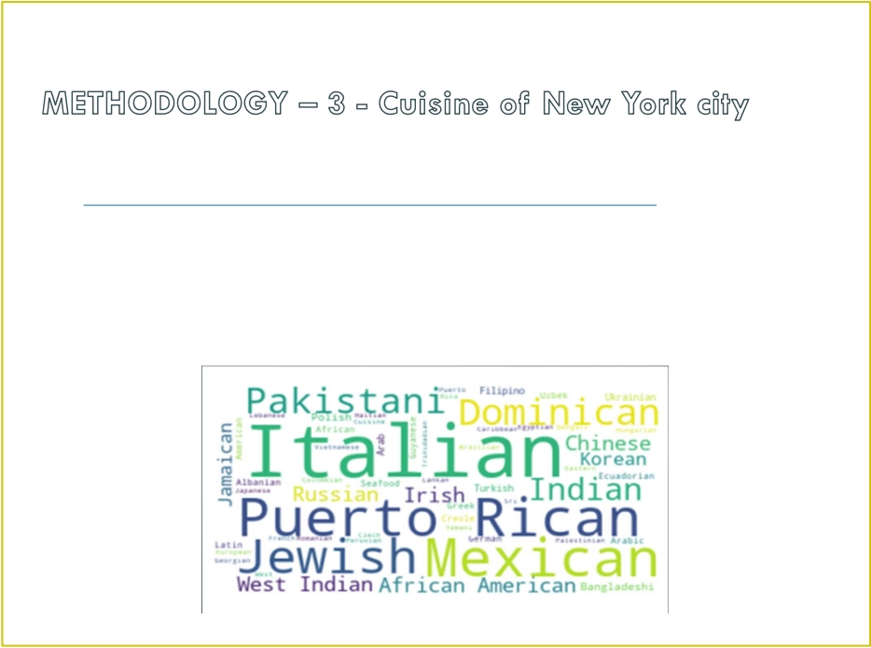
• This data has been manually prepared . Data is taken from Wikipedia page
- https ://en.wikipedia.org/wiki/Cuisine_of_New_York_City
• Data used to create word cloud .
NEW YORK CITY CUISINE : Most Preferred Food in New York City – Italian , Purto
Rican , Mexican , Jewish , Indian , Pakistani & Dominican

Slide 19
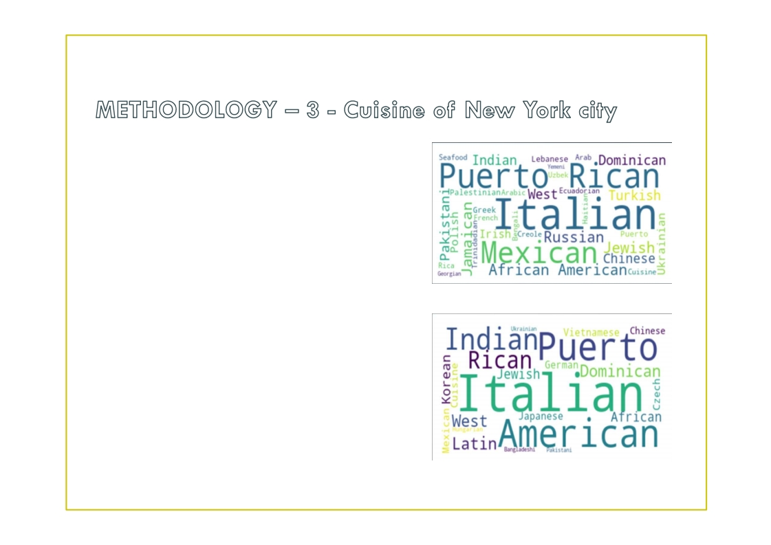
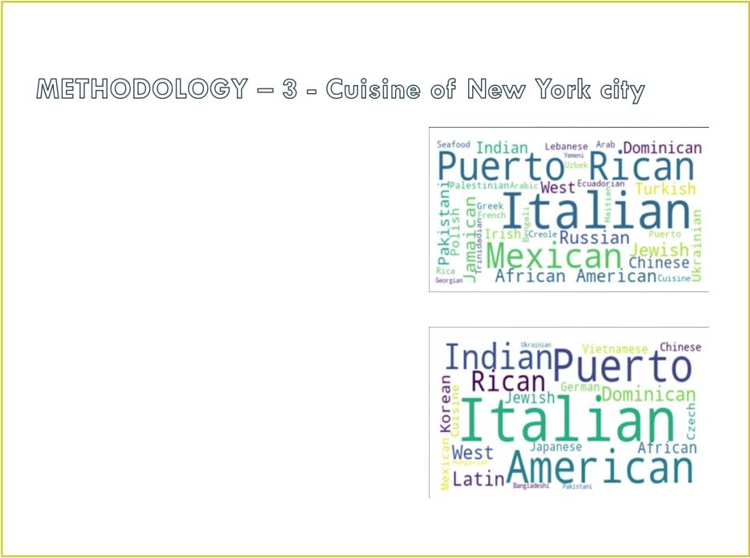
• BROOKLYN CUISINE - Most Preferred
Food in Brooklyn is – Italian , Purto Rican
& Mexican
• MANHATTAN CUISINE - Most Preferred
Food in Manhattan is – Italian , American ,
Puerto Rican and Indian .

Slide 20
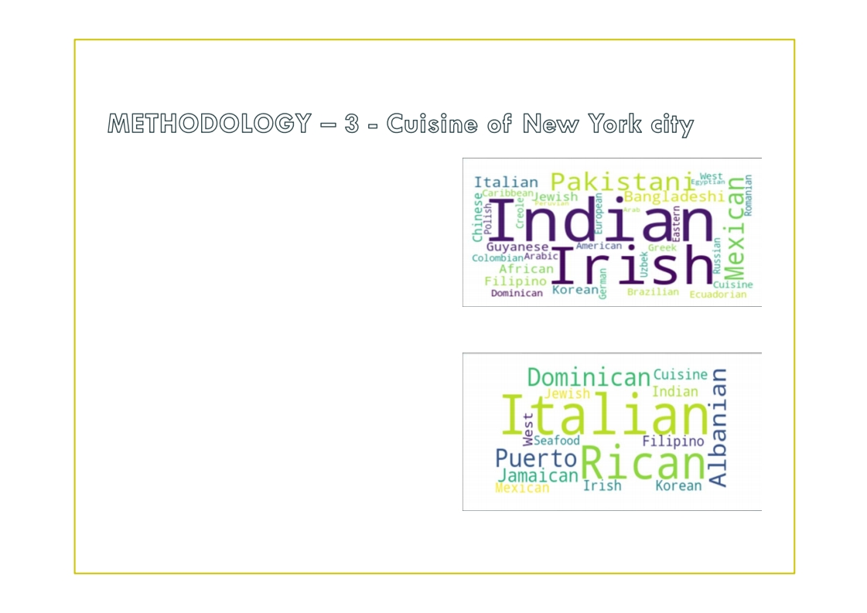
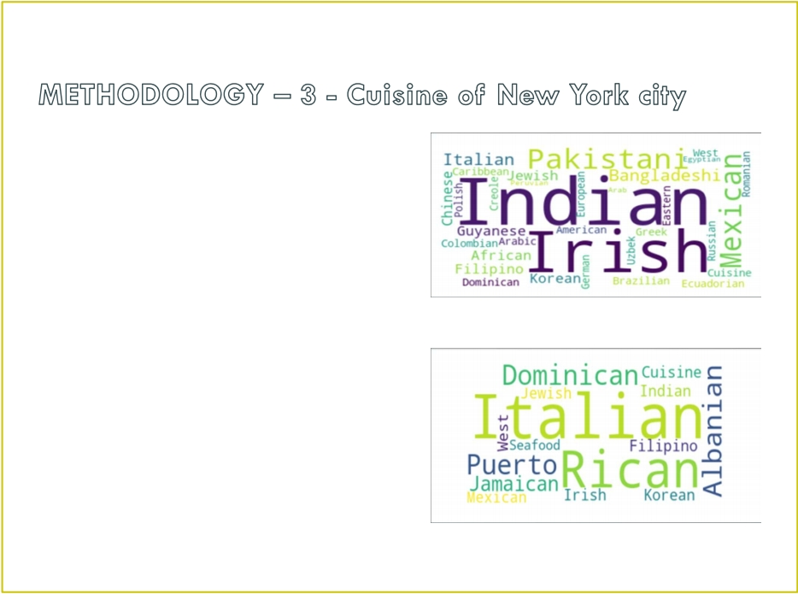
• QUEENS CUISINE - Most Preferred
Food in Queens is – Indian , Irish ,
Pakistani and Mexican .
• THE BRONX CUISINE - Most
Preferred Food in The Bronx is –
Italian , Puerto Rican , Albanian and
Dominican .

Slide 21


• NewYork city geographical coordinates data has be utilized as input for the
Foursquare API , that has been leveraged to provision venues information for each
neighborhood .
• We used the Foursquare API data to explore neighborhoods in New York City .
• Using the geographical coordinates of each neighbourhood foursquare API
calls are made to get top 200 venues in a radius of 1000 meters
PART – 1 Brooklyn and Manhattan
PART – 2 Bronx , Queens and Staten Island

Slide 22
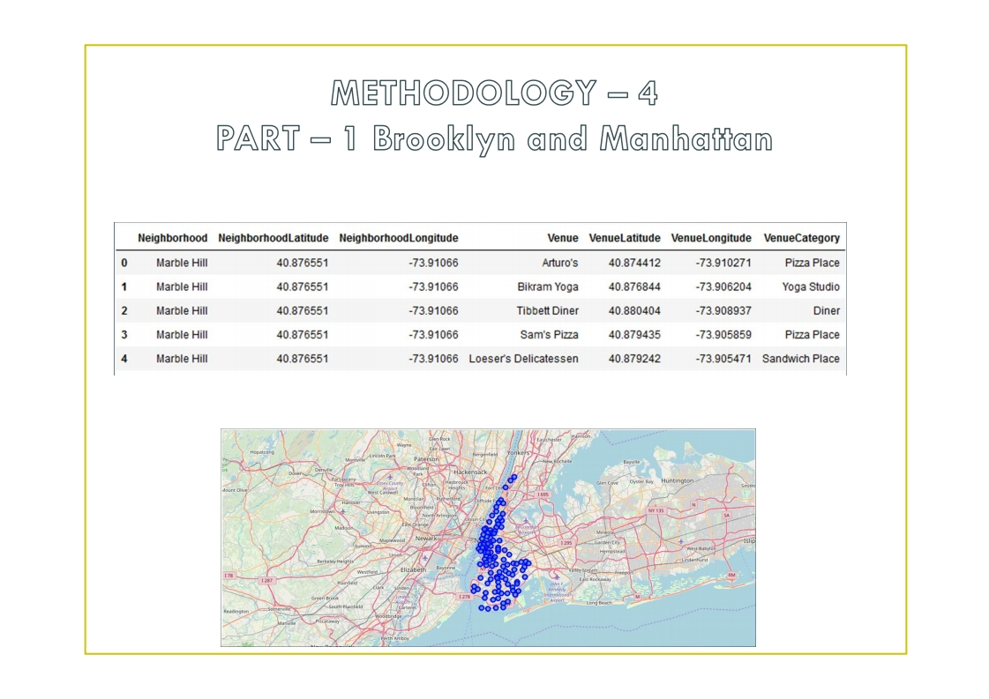
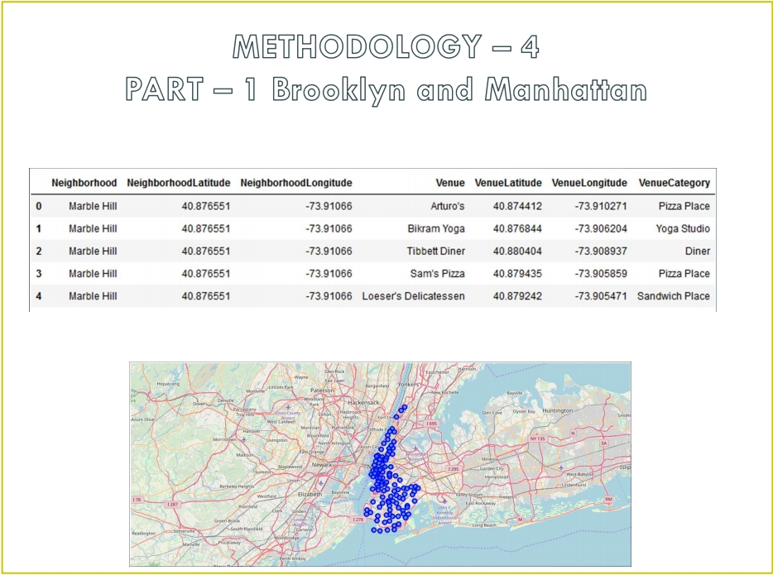
Brooklyn and Manhattan Venues data
Brooklyn and Manhattan Visualization

Slide 23
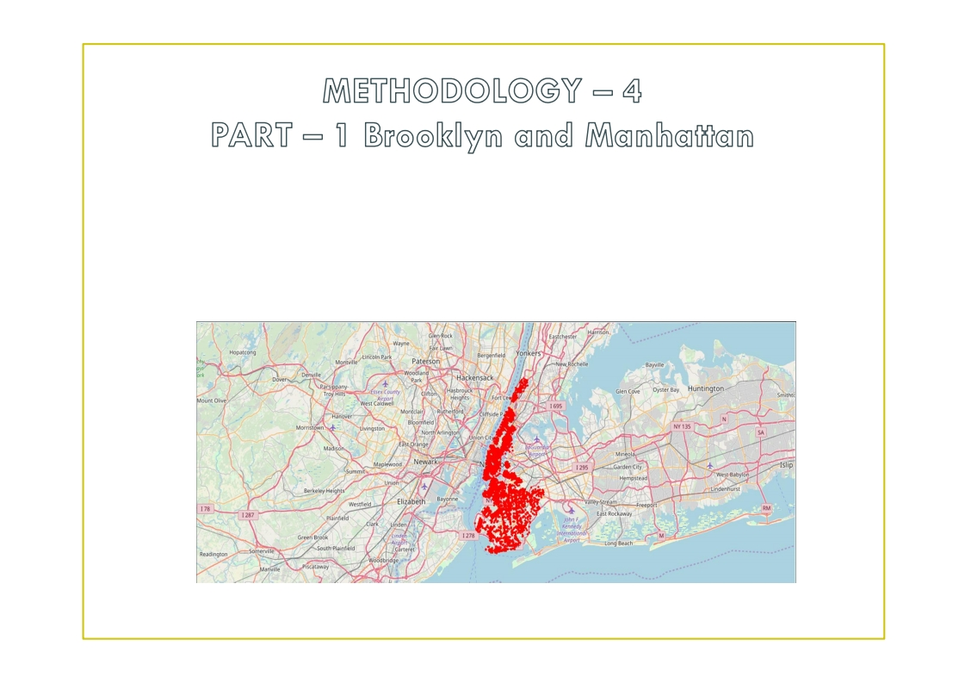
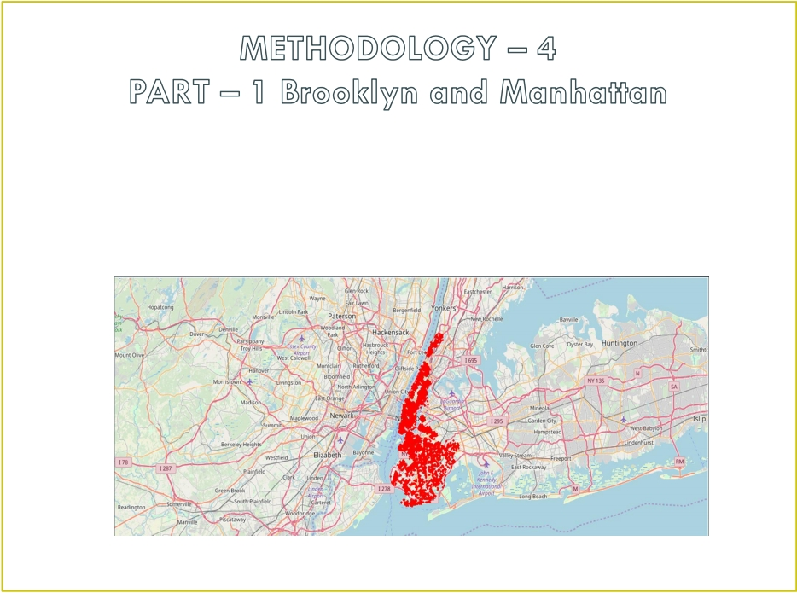
Brooklyn and Manhattan Venues Visualization : Generated the below Brooklyn and
Manhattan Venues Visualization . The
" BM_venues " dataframe has 9708 venues and 397 unique venue types .

Slide 24
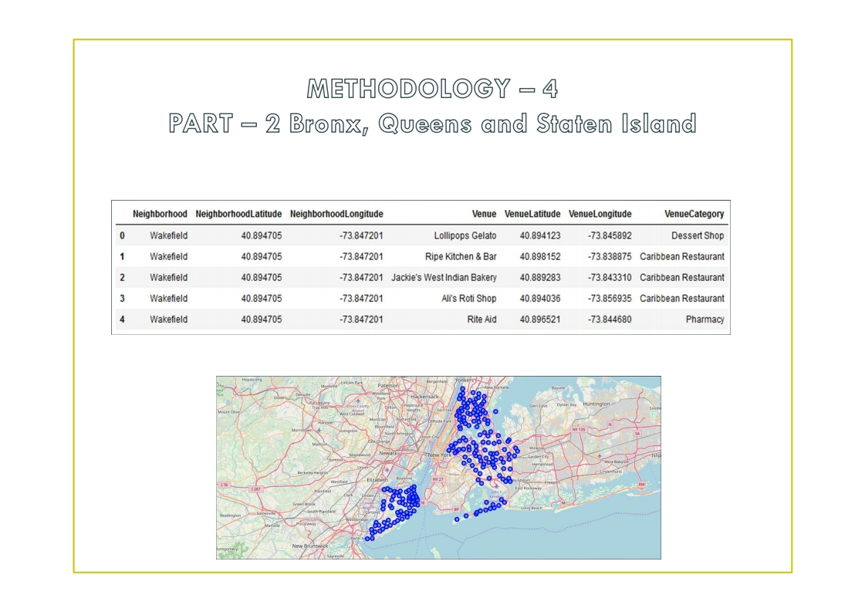
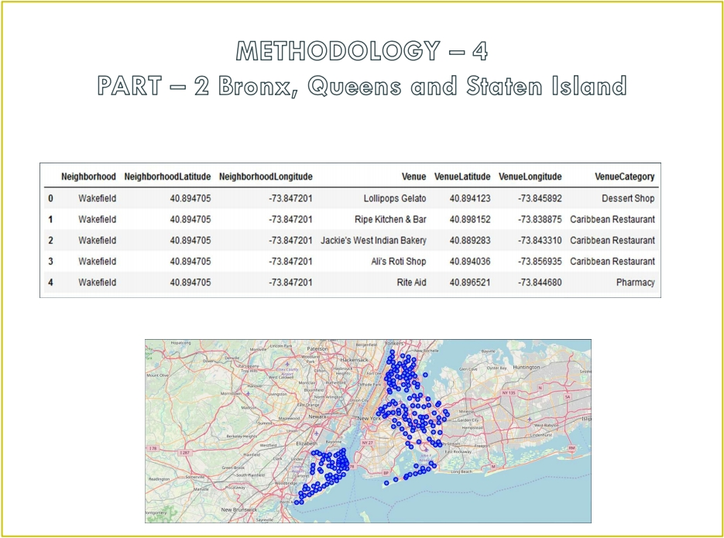
Bronx , Queens and Staten Island Venues data
Bronx , Queens and Staten Island Visualization

Slide 25
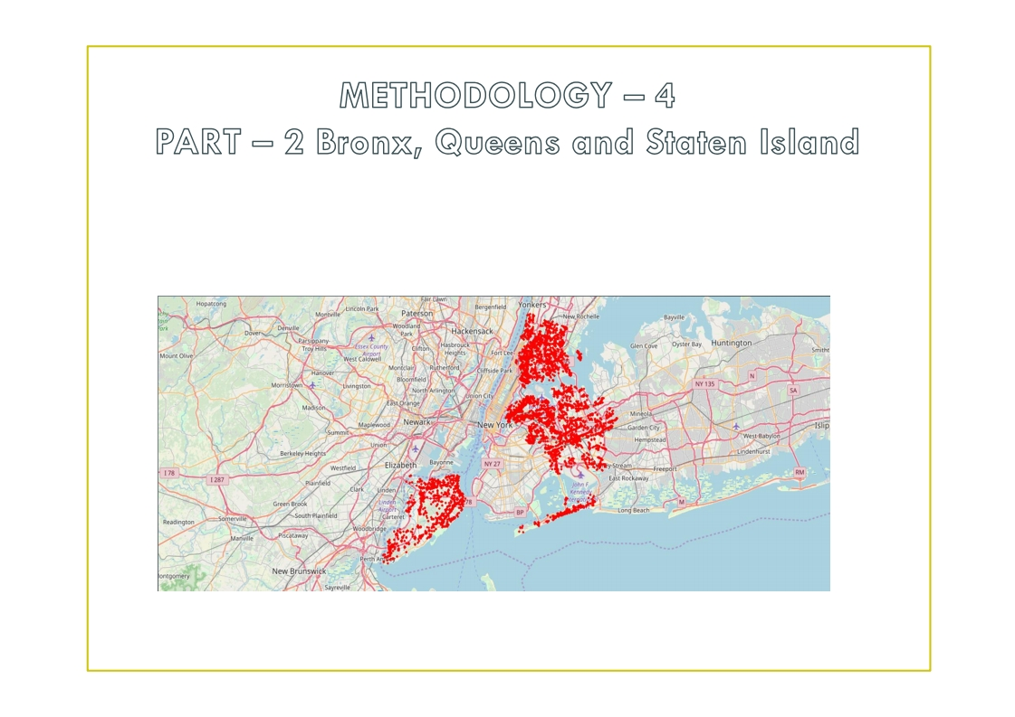
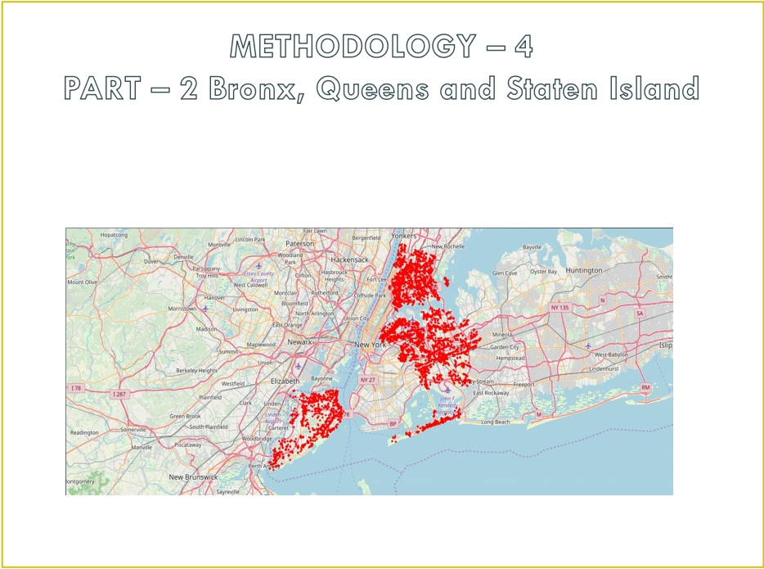
Bronx , Queens and Staten Island Venues Visualization : The " BQS_venues "
dataframe has 10805 venues and 387 unique venue types .

Slide 26
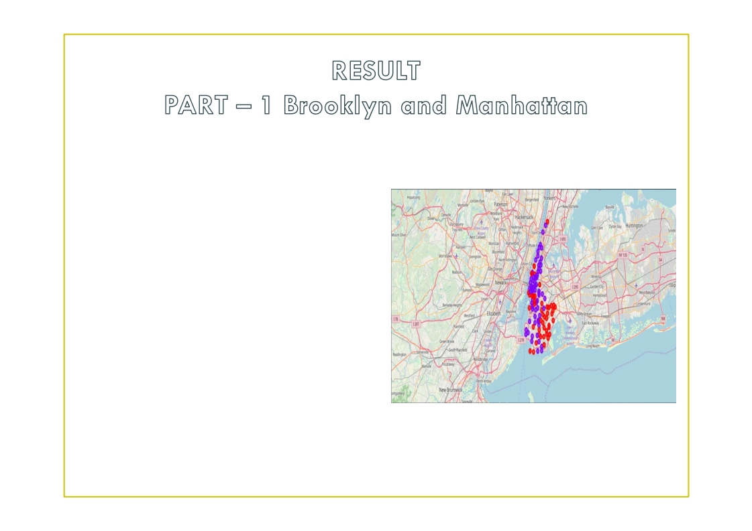
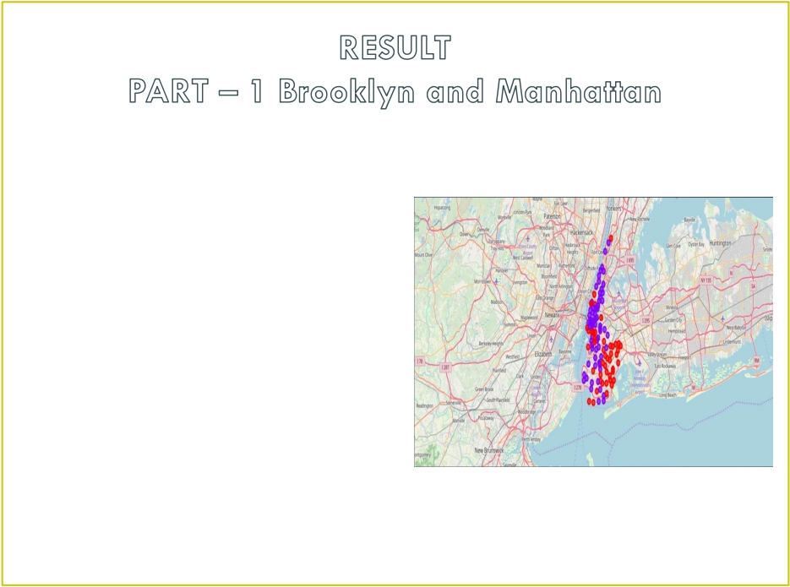
• Segmenting and Clustering
Neighborhoods
- Cluster 0 : The Total and Total Sum of
cluster 0 has smallest value . It shows
that the market is not saturated .
- Cluster 1 : The Total and Total Sum is
very high . Lot of competition .
Saturated neighborhoods .

Slide 27
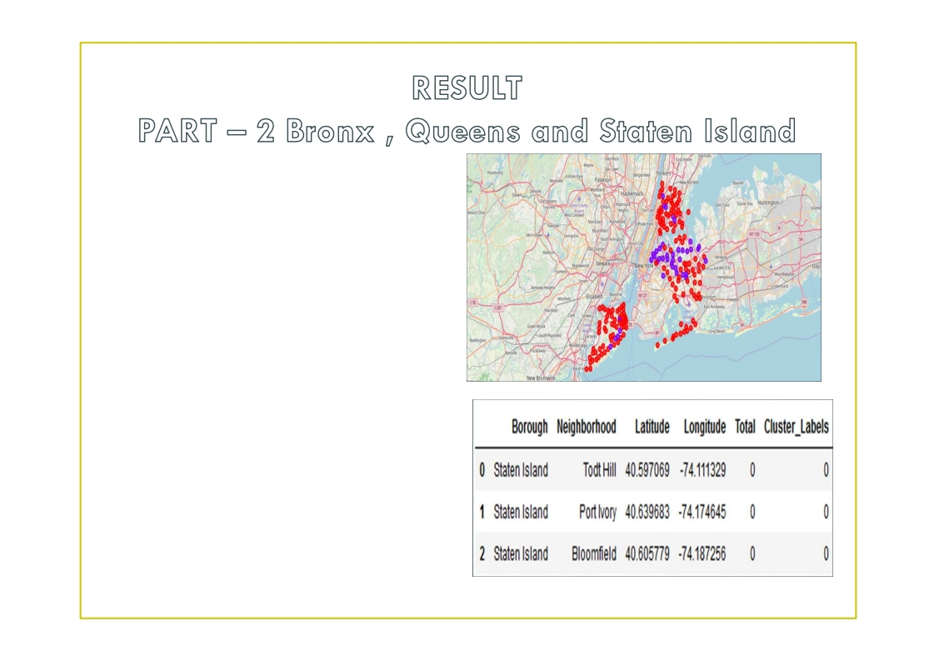
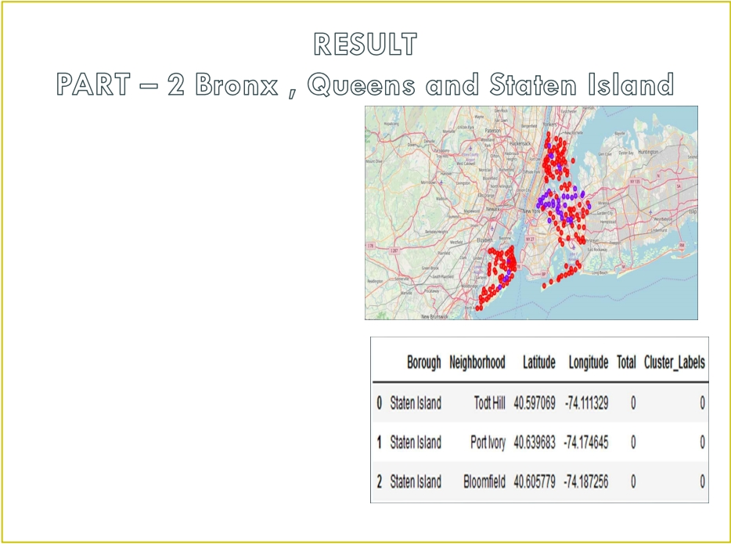
• Segmenting and Clustering
Neighborhoods
- Cluster 0 : The Total and Total Sum of
cluster 0 has smallest value . It shows
that the market is not saturated . There
are untapped markets .
- Cluster 1 : The Total and Total Sum is
very high . Lot of competition .
Saturated neighborhoods .

Slide 28
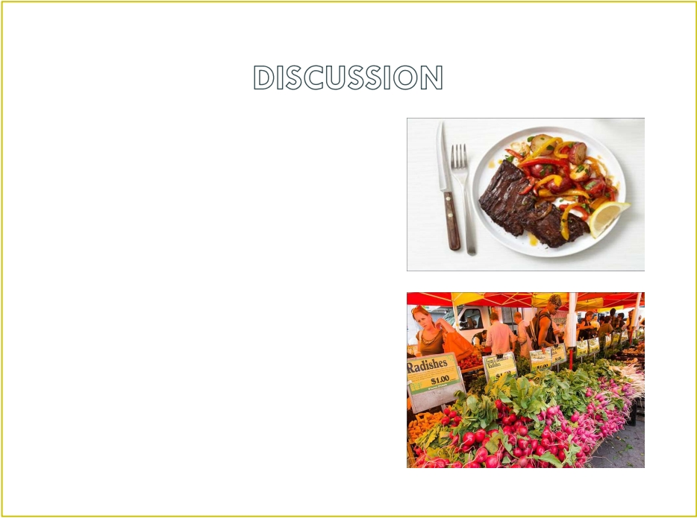

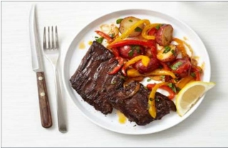
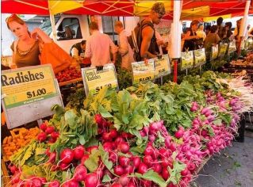
• Scope to explore cuisines of various
countries in Bronx , Queens and Staten
Island
• In Manhattan and Brooklyn restaurants ,
cuisines of many countries are part of their
Menu . Risk can be taken with great menu
on board . It also shows people love and
explore cuisines of various countries .
• Scope to increase Farmers markets in Bronx
, Queens and Staten Island .
- Region - Cluster 0
- Neighborhood – Staten Island –
Tod Hill , Port Ivory , Bloomfield

Slide 29
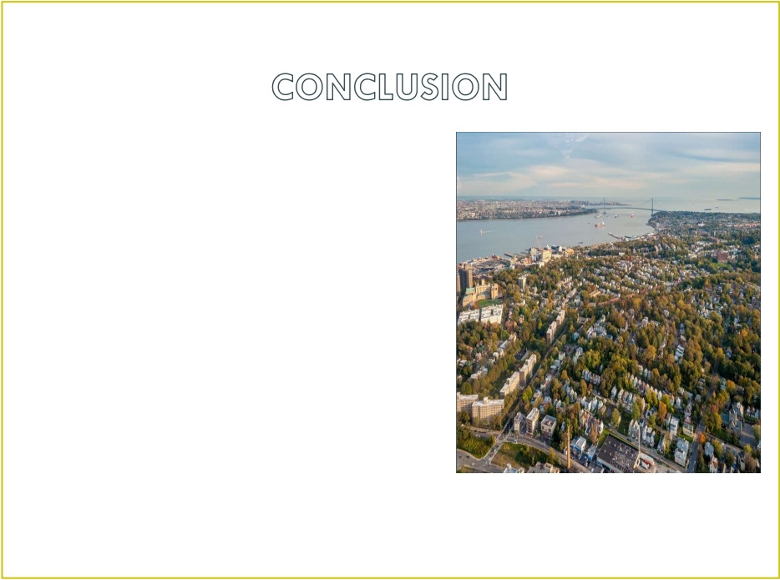

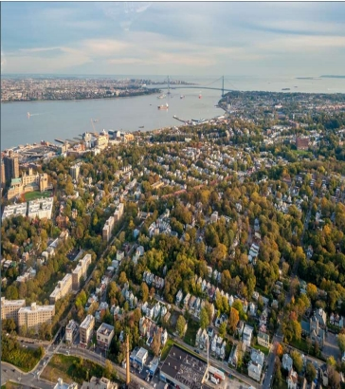
• Analysis performed on limited data
• Re - run program with updated information •
Brooklyn and Manhattan has high
concentration of restaurant business . Very
competitive market .
• Bronx , Queens and Staten Island also has
good number of restaurants but not as
many as required . So this can be explored .
• As per the neighbourhood or restaurant
type mentioned like Indian Restaurant ,
analysis can be checked . A venue with
lowest risk and competition can be
identified

